Slide 1

Student Accounts Office
Zimbar Hall

Slide 2
Laura
Wanda
Andres
Cathryn _ Cashier
Leslie
Our Student Account’s Office

Slide 3
How to
VIEW MY BILL

Slide 4
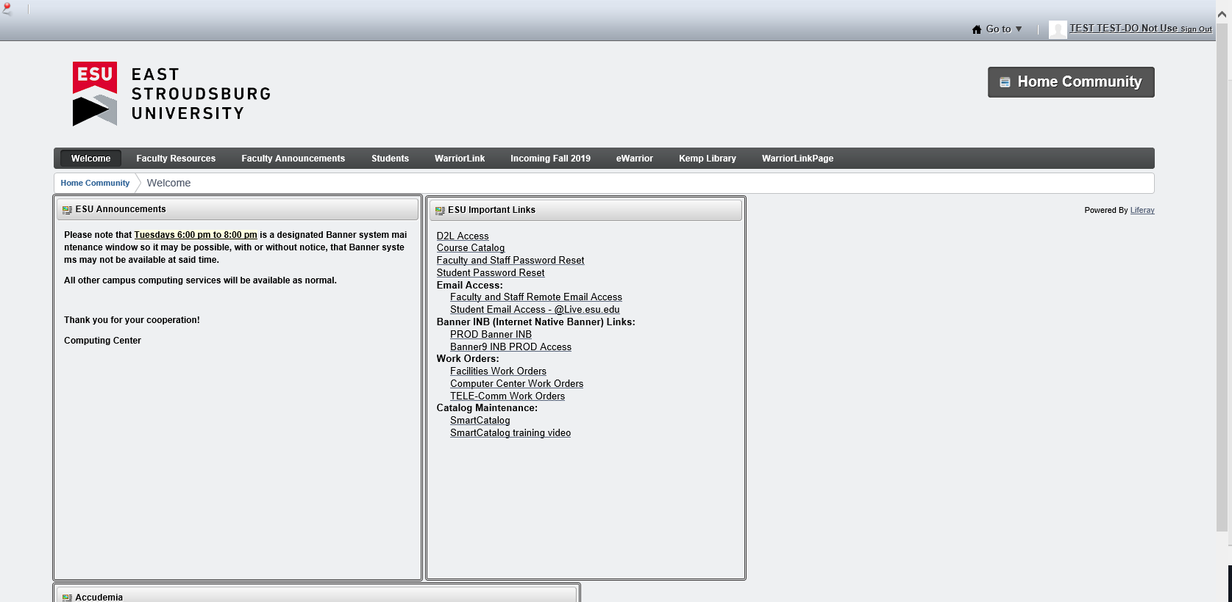
**Log in to your student portal and click on the STUDENT tab.

Slide 5
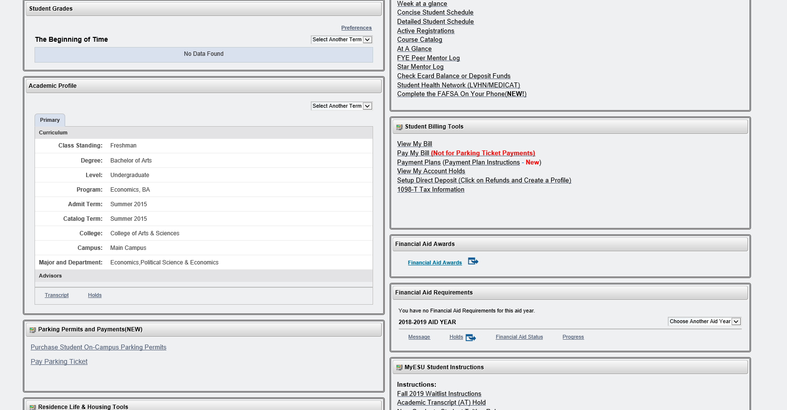
Find Student Billing Tools and click View My Bill.

Slide 6
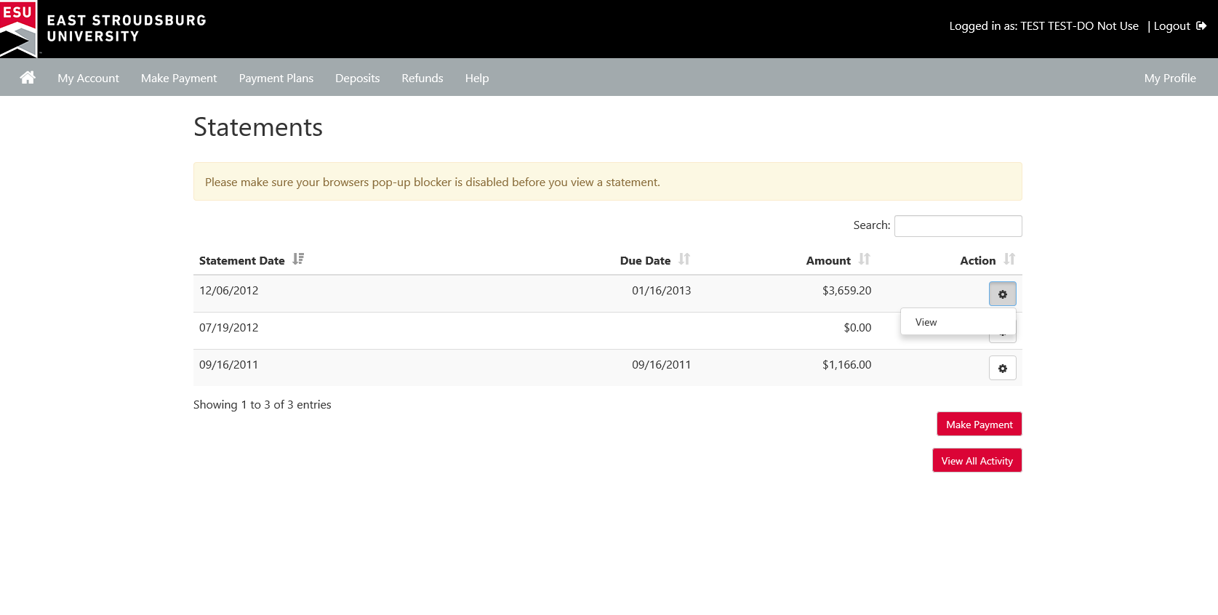
** Click on the gear next to the statement you would like to view.

Slide 7
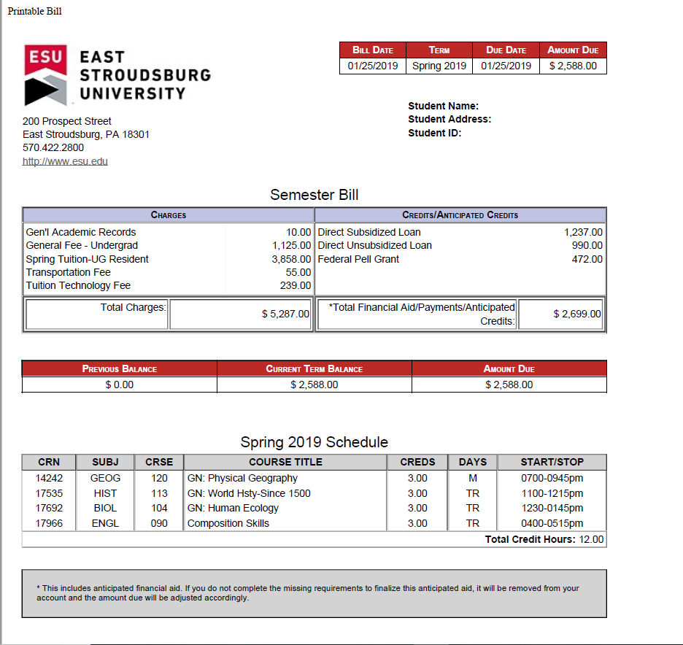
This shows all charges and payments for the semester plus your schedule at the bottom.
A copy of your bill will pop up as a PDF!
(Make sure you have your pop up blocker turned off!)

Slide 8
How to
Add an
Authorized User
You can authorize others, like your parents, the ability to view and pay your bill….

Slide 9
To add an Authorized User, click the Student tab…

Slide 10
Again, click View My Bill…

Slide 11
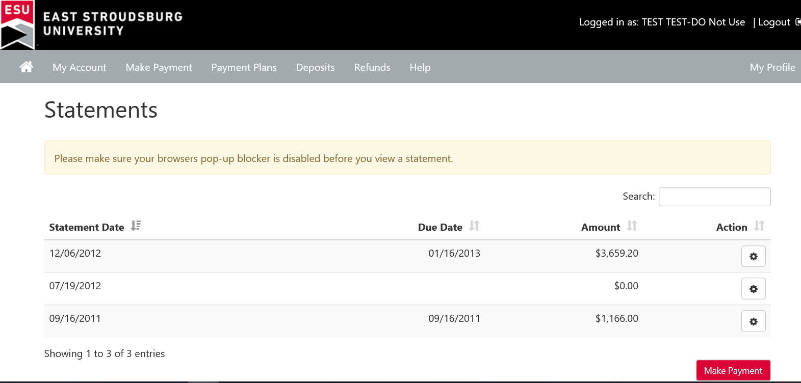
Click the Home icon…

Slide 12
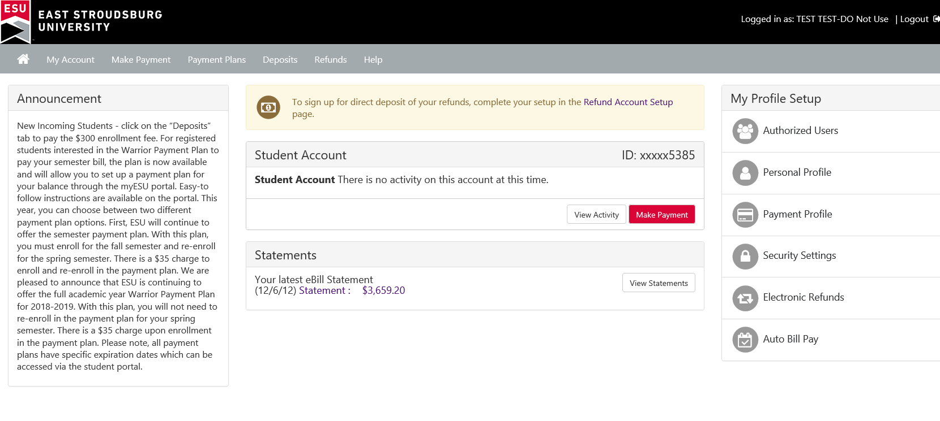
…And click here to add an Authorized User.

Slide 13
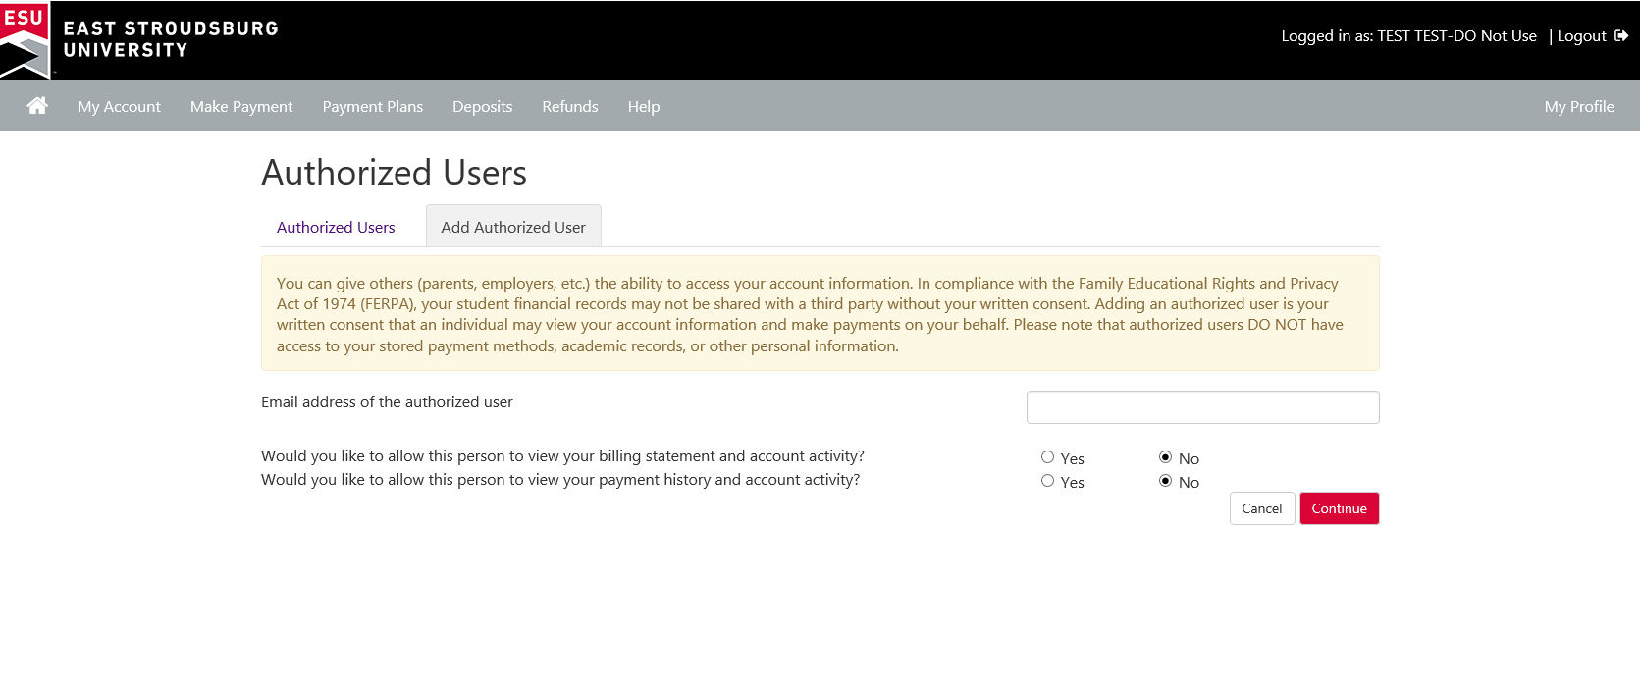
Simply type in the Authorized User’s email address and check the YES or NO boxes.
This person will receive an email to complete the process and create their own password.

Slide 14
Refunds
Educational related expenses: books, living expenses
Direct Deposit
Check your ESU email !

Slide 15
FERPA
Family Educational Rights and Privacy Act

Slide 16
Warrior Payment Plan
Our Warrior Payment Plan gives you the convenience of making monthly payments throughout the semester.

Slide 17
Online payments can be made through your portal 24/7. You can also mail in payment or pay in person provided that on campus access is available.
Sign up for the Warrior Payment Plan through your ESU portal.
In July, we offer the Fall 2020/Spring 2021 Academic Year Payment Plan:
With this plan, students will automatically be enrolled into the spring 2021 payment plan in December 2020 after the spring 2021 bill is issued. Students must be registered for the spring 2021 semester for the rollover to process. *Please note, this plan does not offer automatic withdrawals from a bank account or credit card. Students will have to log into the student portal and make monthly payments. There is one yearly $35.00 fee when you enroll.
We also offer, starting in July, a fall only payment plan. Then in December, when the spring bill is issued, we offer a spring only payment plan. The cost is $35 per semester to enroll.
Complete details including deadlines can be found on the ESU website under Tuition and Fees/Pay My Bill or https://www.esu.edu/tuition/pay-bill.cfm .

Slide 18
How to
Accept Your Financial Aid Awards

Slide 19
Again, under the Student tab on your portal, you will see Financial Aid Awards. Click here…

Slide 20
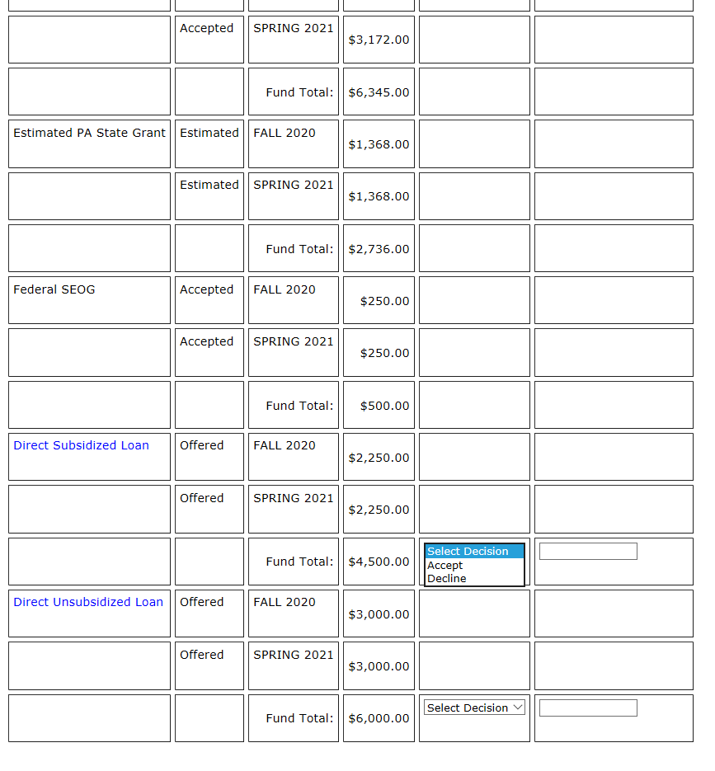
You will see a table showing the aid you are eligible for and a drop down next to any aid that must be accepted.
If you don’t accept the loans in this table, they cannot apply to your account. ☹

Slide 21
We are always here to help and answer your questions!
Don’t hesitate to contact us at billing@esu.edu!
And of course, when we are back on campus, you’ll find us in Zimbar Hall!
Welcome to ESU!

Slide 22


