Slide 1

The Office of Financial Aid
Zimbar-Liljenstein Hall - Suite 100
Phone: 570-422-2800
Fax: 570-422-2850
E-mail: fa@esu.edu

Slide 2
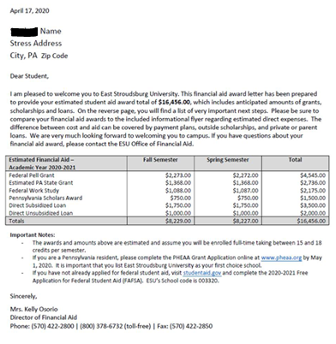
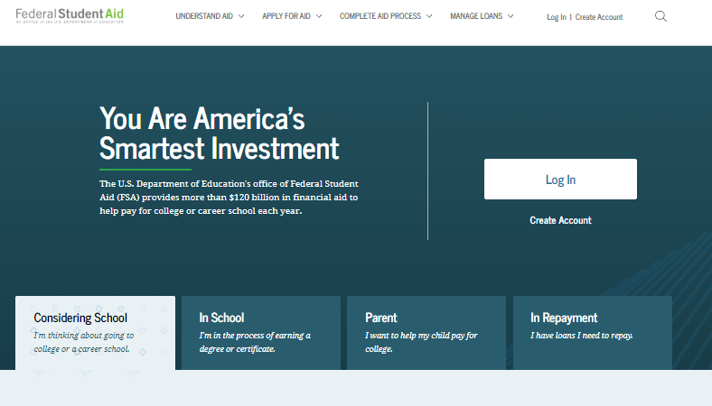
FAFSA and your Award Letter
To complete your FAFSA:
Visit – studentaid.gov
Create your FSA user ID and password
(students and parents will need their own)
Complete your FAFSA
(ESU’s school code 003320)
Your Award Letter from ESU:
Sample:

Slide 3

What is Financial Aid?
Financial Aid is an umbrella term that includes:
Grants
Scholarships
Work-Study
Loans
Any other funds that do not come from you

Slide 4
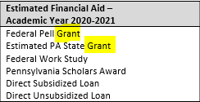
Description of Awards
Grants – Money that does not need to be paid back
(Eligibility is typically determined based on a student’s FAFSA)
Federal Pell Grant
  Awarded to those with exceptional financial need as determined by the FAFSA
Federal Supplemental Educational Opportunity Grant (FSEOG)
  Awarded to those with exceptional financial need as determined by the FAFSA
  Funds are limited and not all students who meet eligibility will receive this award
Pennsylvania State Grant
  Awarded to those with financial need as determined by the FAFSA
  Awards are determined through PHEAA (www.pheaa.org)
Institutional Grant Awards
  Awarded by the Admissions Office at ESU

Slide 5
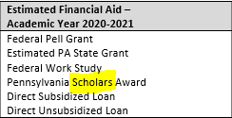
Description of Awards
Scholarships – Money that does not need to be paid back
(Eligibility is typically determined based on need and/or merit)
Institutional Scholarship Awards
  Admissions Scholarships – merit and/or need based scholarships determined at the time of admission
  Foundation Scholarships – merit and/or need based scholarships
  Athletic Scholarships – Decided by the Athletic Director and/or Head Coach
External Scholarship Awards
  www.esu.edu/scholarships
Pennsylvania State System of Higher Education Foundation
  www.thepafoundation.org

Slide 6
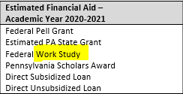
Description of Awards
Work Study – A part-time job where you can earn
money to help pay educational expenses
(Eligibility is determined based on need)
Students apply for positions through Human Resources – Student Employment
Students can work up-to 20 hours per week
Students are paid biweekly (earned wages are not applied to the bill)

Slide 7
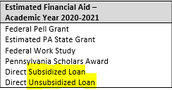
Description of Awards
Federal Direct Loans – Money that needs to be repaid
(Eligibility is determined based on enrollment status and need)
Direct Subsidized Loan
  Based on need
  Interest does not accrue while student is enrolled
Direct Unsubsidized Loan
  Not based on need
  Interest does accrue while student is enrolled
Current interest rate for 2020-2021 undergraduate loans is 2.75%.
An origination fee is charged to the borrower (deducted from the loan disbursement)
Current origination fee for undergraduate loans disbursed before 10/1/20 is 1.059%.

Slide 8
Federal Direct Loan Requirements
Requirements for Disbursement:
Entrance Counseling
  Entrance counseling explains the obligations you agree to meet as a condition of borrowing a Direct Loan
Master Promissory Note (MPN)
    A legal document in which you promise to repay your loan(s) and any accrued interest and fees to the U.S. Department of Education
Repayment
  Repayment begins six months after leaving school or following below half-time
  To see who your student loan servicer is (who you will submit payments to), please visit studentaid.gov
Entrance Counseling and MPNs can be completed on studentaid.gov
You will need your FSA user ID and password

Slide 9
Cost of Attendance (COA)
Cost of attendance is the estimated amount it will
cost a student to attend a college
(When awarded financial aid, the total of all awards cannot exceed a student’s COA)
Direct Costs – Costs that are billed to the student by the school
  Tuition
  Fees
  Room – if living on campus
  Board – if selected by the student
Indirect Costs - Necessary expenses related to attendance, but not billed by the school
  Books
  Supplies
  Room and board – if commuting
  Transportation
  Miscellaneous

Slide 10
Federal Direct Parent Loan (PLUS)
Direct PLUS Loans are federal loans that parents (biological or adopted) of dependent undergraduate students use to help pay for educational expenses
(Eligibility is based on the borrower’s credit worthiness)
Interest accrues throughout the life of the loan, including while the student is enrolled in school
  Interest rates are fixed
The borrower is charged an origination fee
  The origination fee is deducted from the loan disbursement before the borrower receives the funds
  If a parent is denied a PLUS loan, the student will be eligible to receive an additional $4,000 in unsubsidized loan funds as a first-year student
  To apply for a PLUS loan, please visit studentaid.gov
  Parents will need to log in with their FSA user ID and password

Slide 11
Private Student Loans
Private student loans, like federal student loans, can be used to pay for college costs, but they originate with a bank, credit union or online lender rather than the federal government
Terms and conditions are determined by the lender
  Interest rates may be variable or fixed
  Read the small print before you sign
Loans are based on a credit check
  Most students lack credit history, requiring a co-signer
  To explore private student loan options and to compare different lenders, please visit: elmselect.com

Slide 12
FAFSA Verification
What is verification?
Verification is the process a school uses to confirm that the data reported on your FAFSA form is accurate
Why were you selected for verification?
The Department of Education selects FAFSAs at random
The school may select a FAFSA for verification if there appears to be conflicting information
If you are selected for verification you must complete the verification process
before you can receive federal financial aid.
ESU uses a third-party company, Inceptia to complete the verification process. If you are selected for verification, once you submit the enrollment fee you will receive an email directing you to the Inceptia website (verification gateway) to create your username and password and to submit the required documents

Slide 13
Questions?
The Financial Aid Office is here to explain, clarify,
and answer any questions you may have.
Phone: 570-422-2800
Fax: 570-422-2850
Email: fa@esu.edu

